Slide 1

Business Forecasting
Data-forecasting of an E-Commerce company in the United States
By: Jai Hinduja
Karan Shah
Prerna Sharma

Slide 2
Dataset Description
The dataset consists information on Ecommerce profits of the United States.
Data source: a single company
Overall trend in the United States marketplace regarding various products is shown by the weekly sale’s profit value for different categories like Pantry, Office Supplies, and other lifestyle requirements.
Data collection period: September 2019 - December 2020.
Sales Profit were downloaded in CSV format from Kaggle.
Notes:
Categories: Electronics. Furniture, Health & Wellness, Office Supplies, Pantry, & Style & Fashion

Slide 3
Exploring the Dataset
The overall data showcases the time when Covid hit the United States and impact it made on the Ecommerce sales of the country.
The data frame contains the following columns:
Order Date: This is a date on which the order becomes final and effective; date format mm/dd/yyyy
Category: 6 different categories of items ordered through E-Commerce
Profit: Financial gain in US dollars.
Notes:
Categories: Electronics. Furniture, Health & Wellness, Office Supplies, Pantry, & Style & Fashion

Slide 4
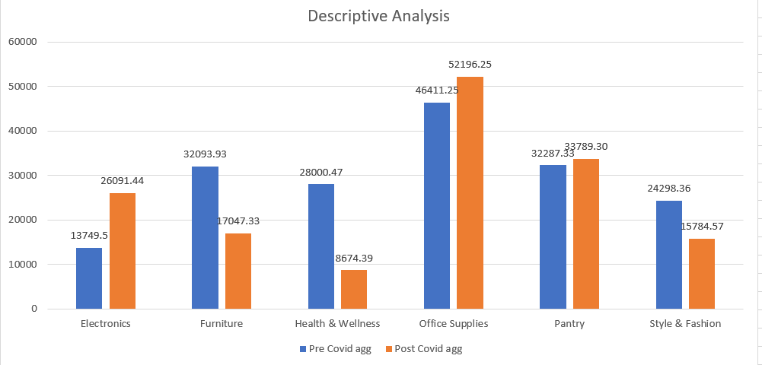
Exploring the Dataset
We have done descriptive analysis to generate accessible insights from otherwise uninterpreted data present in the column Category.
Difference between the profit made by an individual category before Covid-19 and after its impact is calculated.
Notes:
Categories: Electronics. Furniture, Health & Wellness, Office Supplies, Pantry, & Style & Fashion

Slide 5
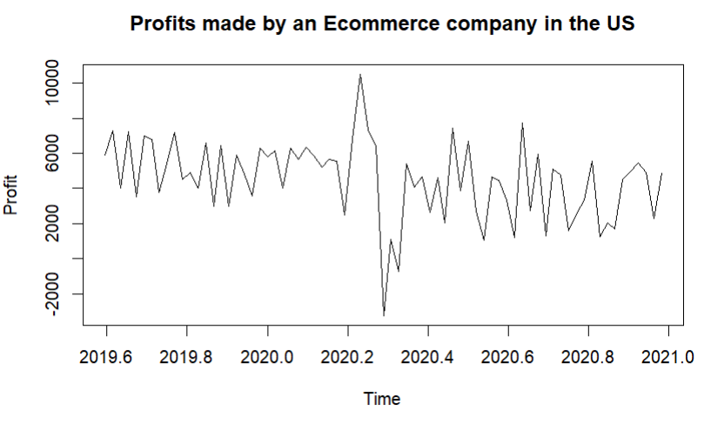

Notes:
Categories: Electronics. Furniture, Health & Wellness, Office Supplies, Pantry, & Style & Fashion

Slide 6
Objective
The main objective is to predict the profit value of the online sales for a single Ecommerce company if we wouldn’t have faced pandemic.
Analysis I - Forecast accuracy comparison pre-covid
To find the predicted value in an ideal case scenario for the Ecommerce profits by considering the pre covid data.
Split the dataset into training and testing to calculate accuracy as per different methods.
Analysis II - Difference between sale’s profit for Covid and non Covid period
Forecasted the data for the next 3 months by considering pre covid period and calculated the difference of the actual profit made as compared to our predictions.
Notes:
Categories: Electronics. Furniture, Health & Wellness, Office Supplies, Pantry, & Style & Fashion

Slide 7
List of Models
Mean
Naïve Method
S Naïve Method
Random Walk Forecasts
Simple Exponential Smoothing
Exponential Smoothing
Arima
Moving Averages
Notes:
Categories: Electronics. Furniture, Health & Wellness, Office Supplies, Pantry, & Style & Fashion

Slide 8
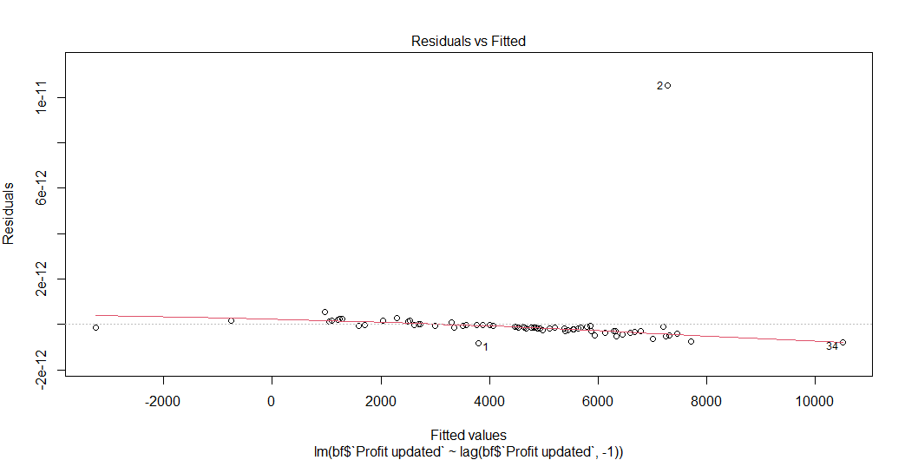
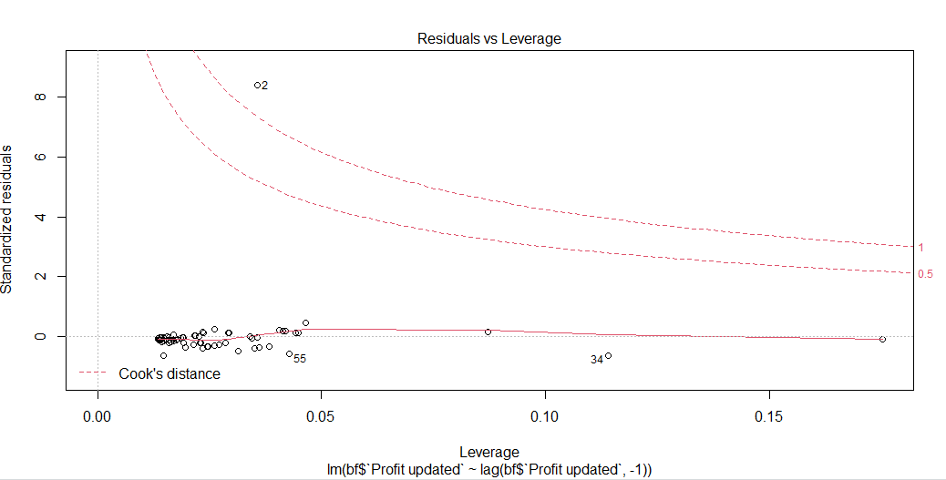
As per the Residual vs Fitted plot, we observed that there is an increasing linear relationship between order date & profit.
As per the Residual vs Leverage plot helps us to find influential cases and we can see that there are significant leverage points.
Notes:
Categories: Electronics. Furniture, Health & Wellness, Office Supplies, Pantry, & Style & Fashion

Slide 9
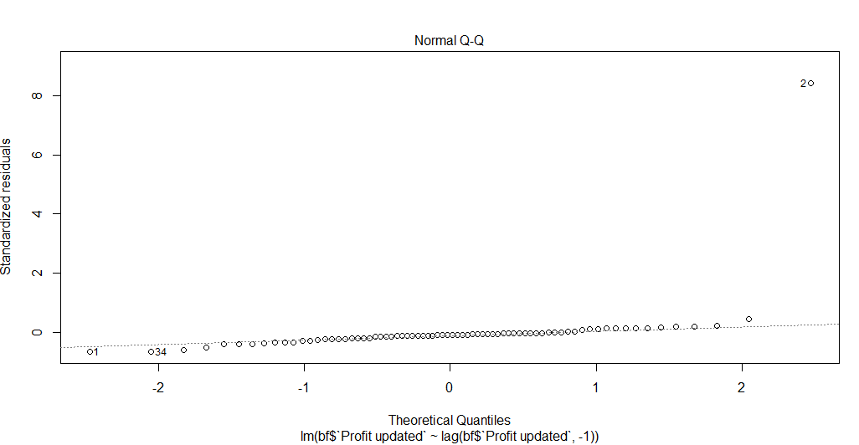
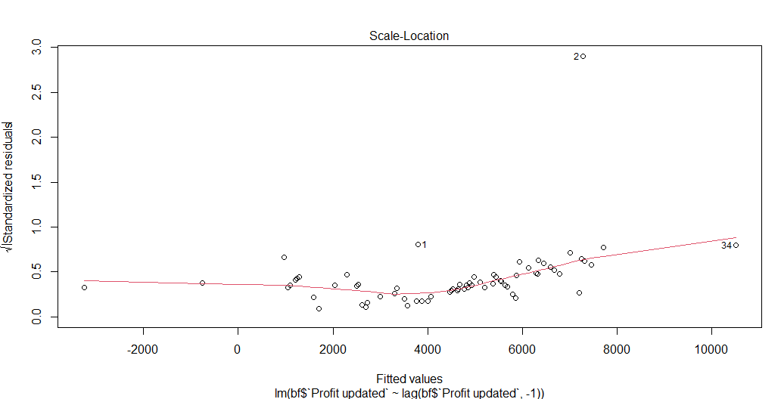
As per the Normal Q-Q plot, errors are less as our predicted and actual values are close enough. It’s a good plot since residuals are lined well on the straight dashed line.
In Scale-Location plot we are taking the square root the error for better visualization, and we can interpret that there is a horizontal line with equally (randomly) spread points making it homoscedastic.
Notes:
Categories: Electronics. Furniture, Health & Wellness, Office Supplies, Pantry, & Style & Fashion

Slide 10
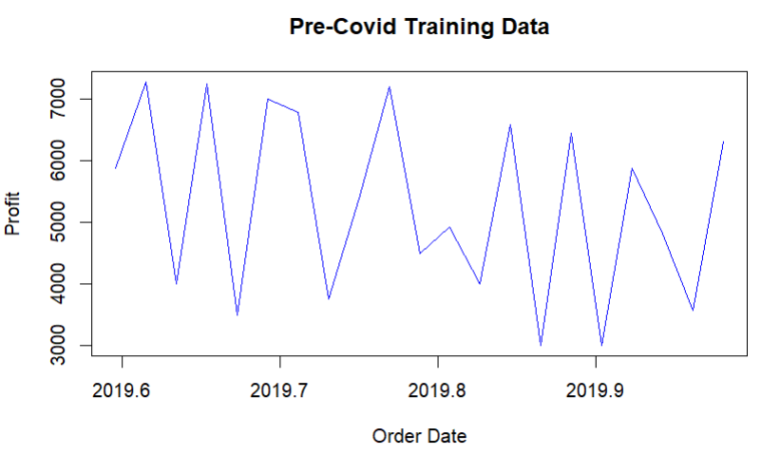
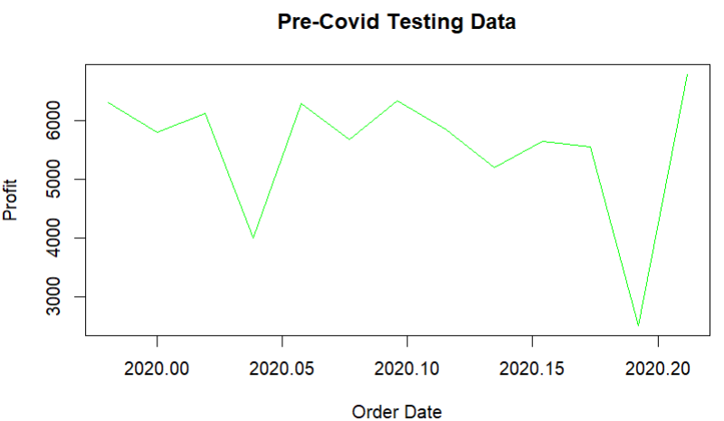


Analysis I-Forecast accuracy comparison pre-covid
Notes:
Skewed left, the mean(5289.284762) is less than the median(5380.4).

Slide 11
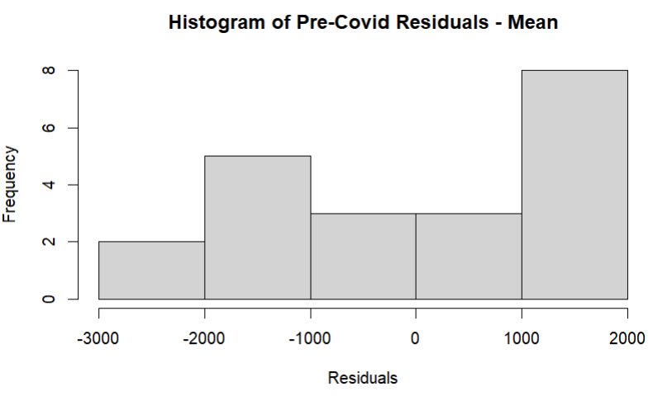
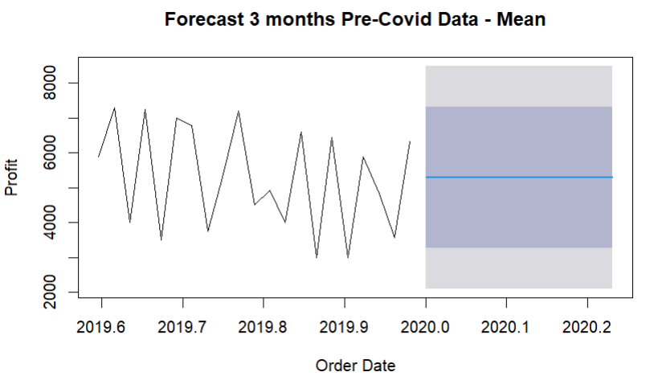
Analysis I – Train Data Mean Method
As per our understanding it is left skewed because company offers Fall sale during the month of August.
Activities like start of schools/colleges, employee intakes, tourist visits increases
Notes:
Skewed left, the mean(5289.284762) is less than the median(5380.4).

Slide 12

Red Line represents the fitted curve of the mean graph which is flat here.
In this scenario residuals are significantly less shown in blue.

Slide 13
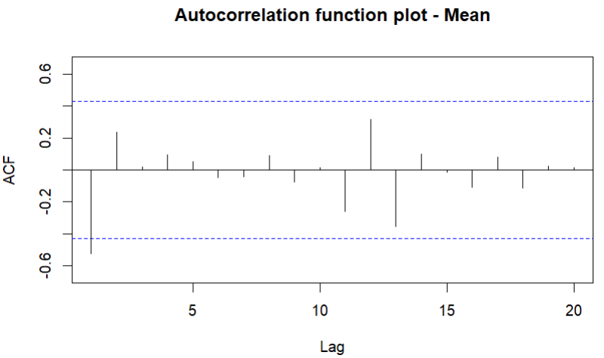
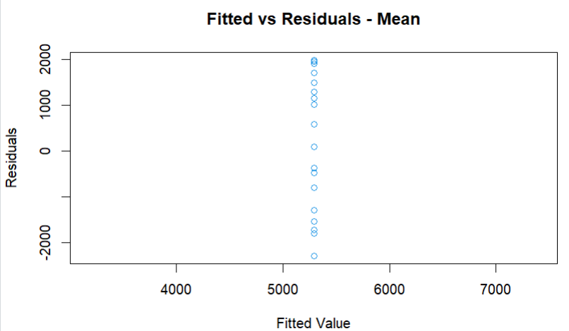
ACF is the plot used to see the correlation between the points, up to and including the lag unit.
The 1st prediction point is significant in our plot.
For Fitted vs Residual an increasing linear relationship between order date and profit is seen.
Notes:
#x- lag and y - deviation (y-t)
##Autocorrelation refers to how correlated a time series is with its past values/

Slide 14
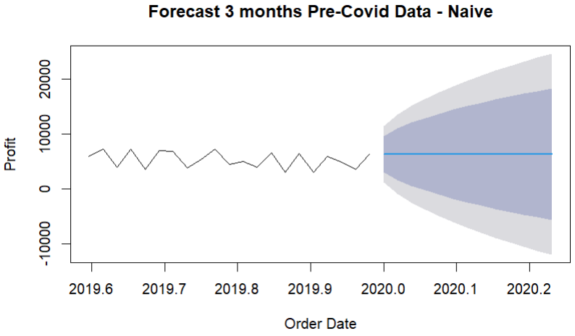
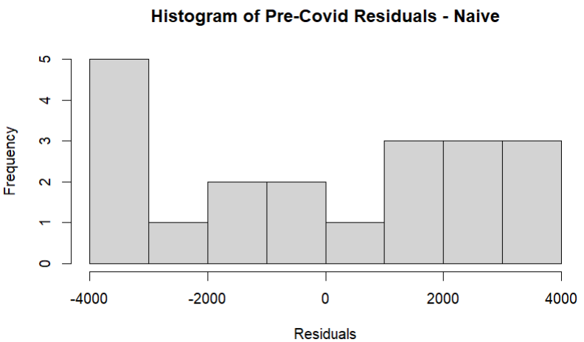
Analysis I – Train Data Naïve Method
Naïve uses the most recent observation and projects that into the future.
Left skewed because company offers Fall sale during the month of August.

Slide 15
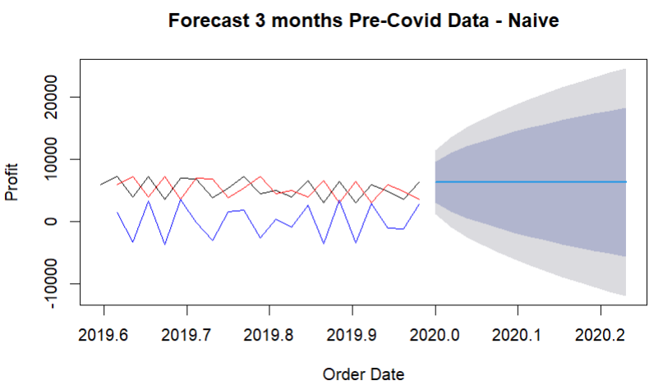
Red Line represents the fitted curve of the naïve and since it considers the last recent value the graph shifted by t+1 interval.
In this scenario residuals are significantly more shown in blue denoting that the data is random.
Notes:
Residual shows the difference between an observation and its fitted value

Slide 16
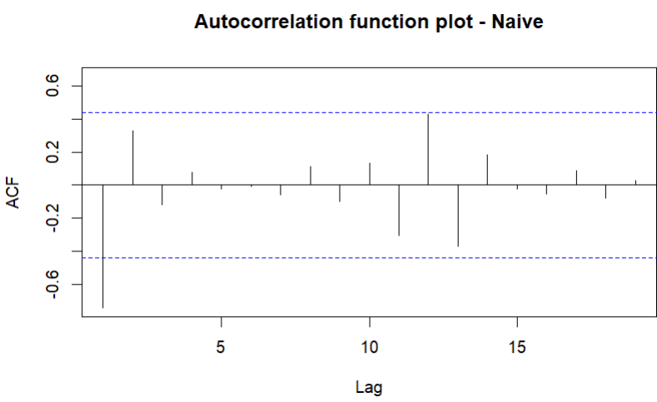
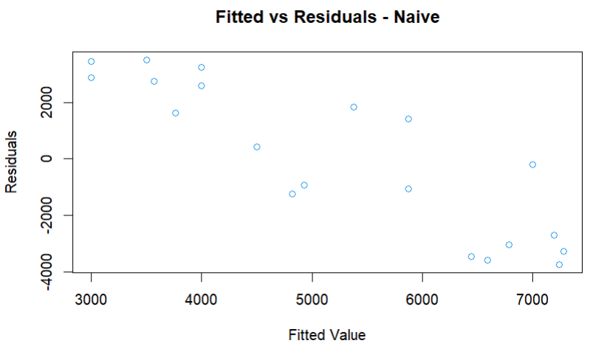
Autocorrelation refers to how correlated a time series is with its past values.
First point is very significant in our plot.
For Fitted vs Residual a decreasing relationship is seen between predicted profit vs actual profit values.
Notes:
#x- lag and y - deviation (y-t)
##Autocorrelation refers to how correlated a time series is with its past values/

Slide 17
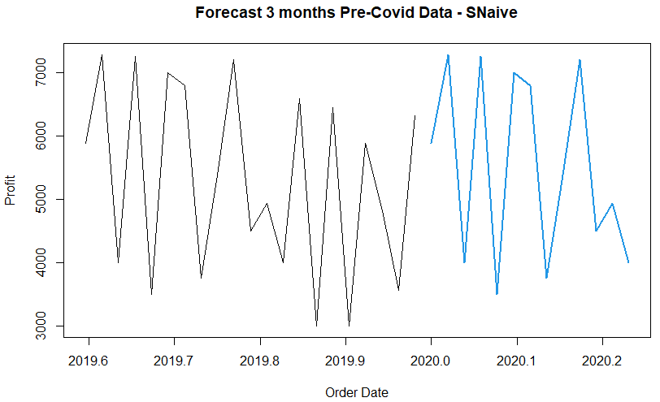
Analysis I – Train Data Seasonal Naïve Method
SNaïve considers the seasonal aspect of the data, and we can see the profit values future 3 months.
Notes:
# Snaive needs 2 periods of data, but we have 22 data points so unable to calculate residuals

Slide 18
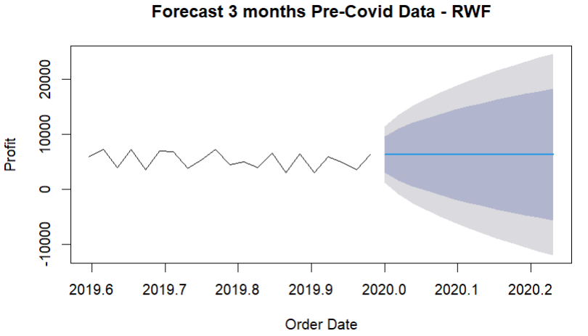
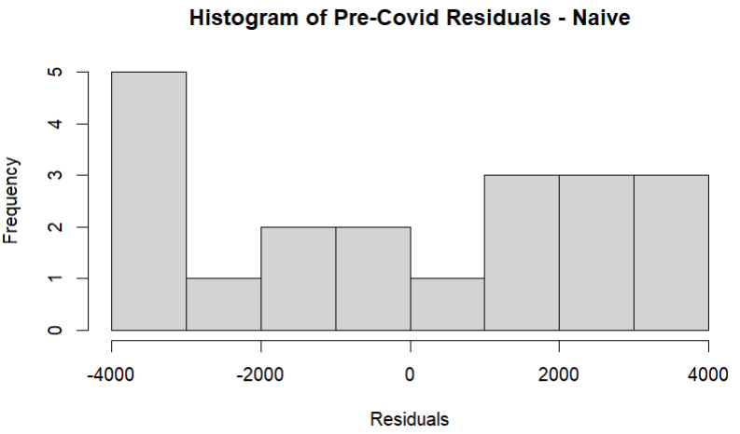
Analysis I – Train Data Random Walk Forecasts Method
Since naive() is simply a wrapper to rwf() for simplicity i.e. our predictions are like previous method.

Slide 19
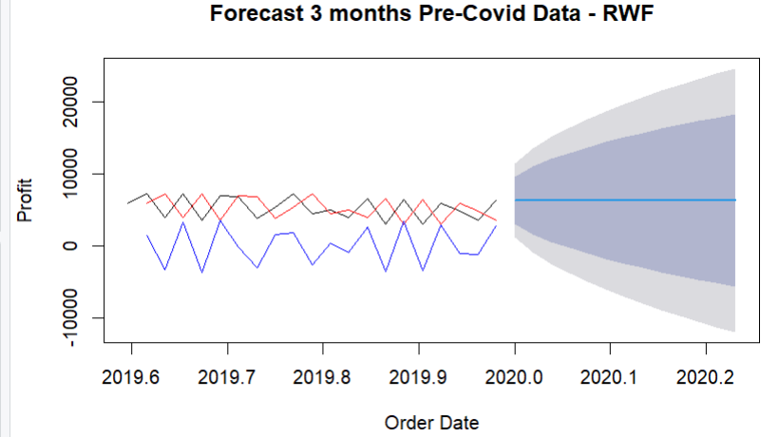
Red Line represents the fitted curve of the naïve and since it considers the last recent value the graph shifted by default drift 1.
In this scenario residuals are significantly more shown in blue denoting that the data is random.

Slide 20
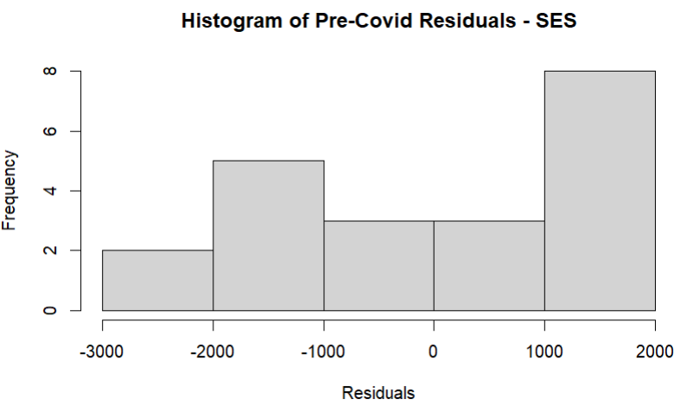

Analysis I – Train Data Simple Exponential Smoothing
Notes:
Simple exponential smoothing
Call:
ses(y = bf.train, h = 13)
Smoothing parameters:
alpha = 1e-04
Initial states:
l = 5289.358
sigma: 1533.745
AIC AICc BIC
375.9229 377.3346 379.0564

Slide 21
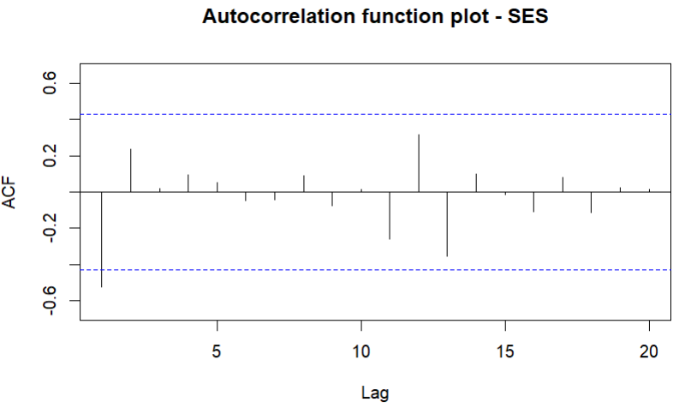
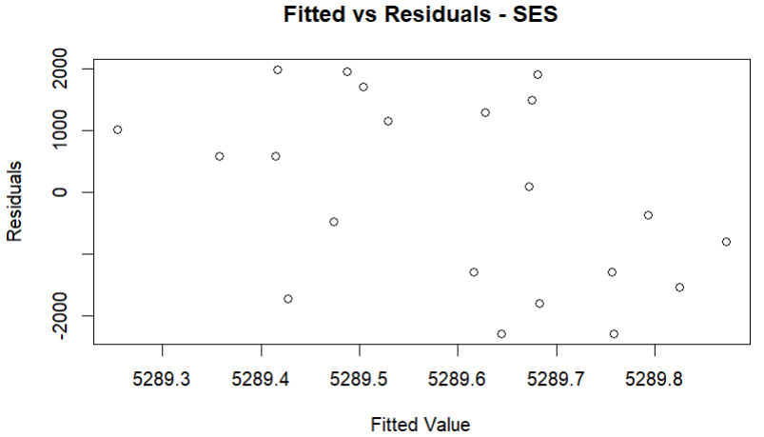
First point is very significant in our plot.
For Fitted vs Residual the data is random.

Slide 22
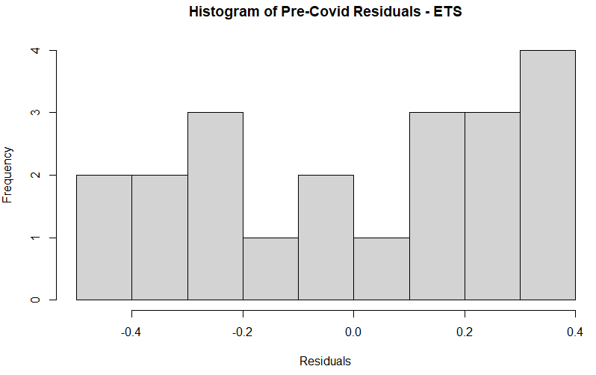
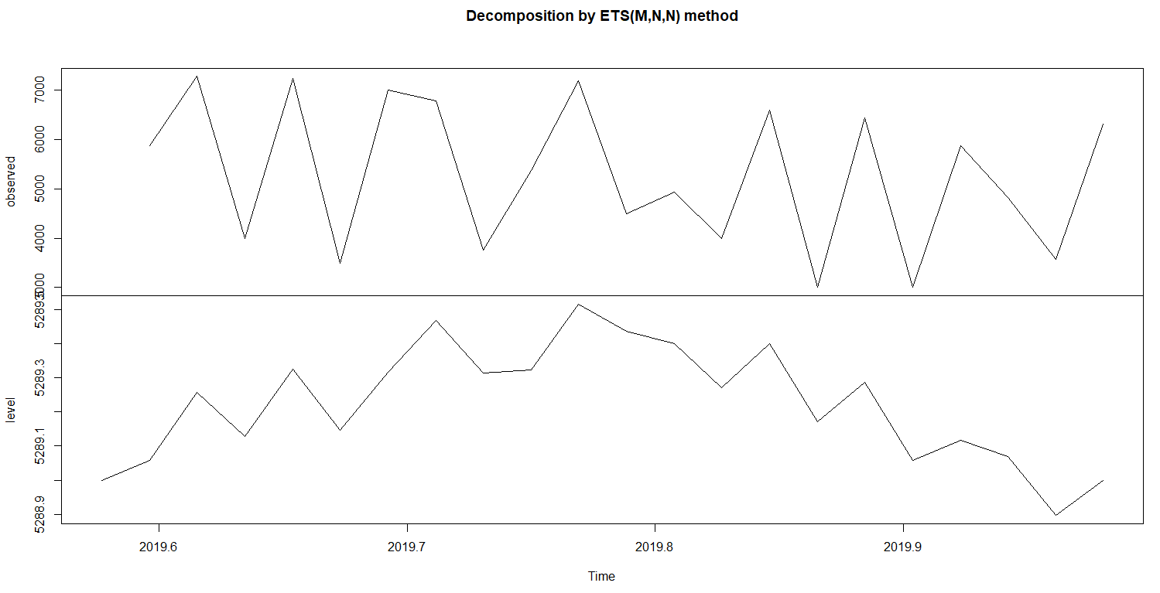
Analysis I – Train Data Exponential Smoothing Method
Notes:
ETS(M,N,N)
Call:
ets(y = bf.train)
Smoothing parameters:
alpha = 1e-04 ->this is the smoothing factor
Initial states:
l = 5288.9991
sigma: 0.29

Slide 23
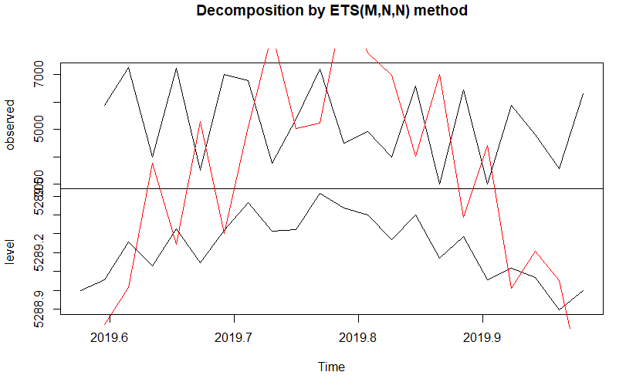
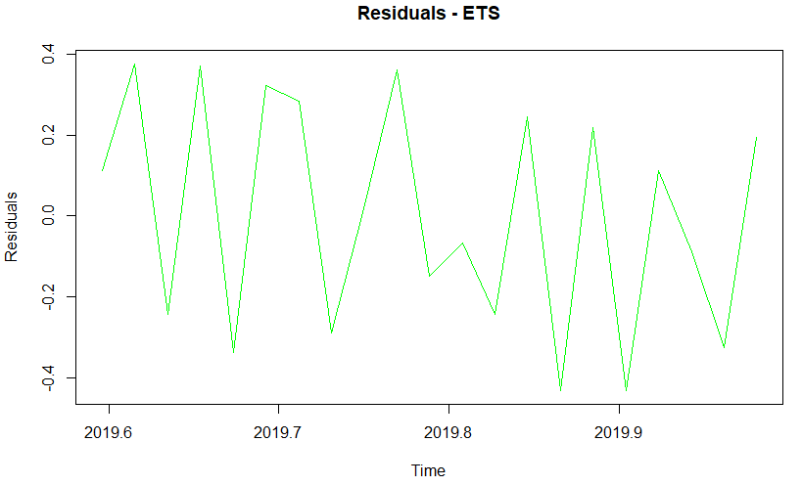
Red Line represents the fitted curve of the naïve and since it considers the last recent value the graph shifted by default drift 1.
Since the residuals are bounded by certain limit, we plotted a separate residual graph.
Residuals are significantly more shown in green denoting that the data is random.
Notes:
ETS(M,N,N)
Call:
ets(y = bf.train)
Smoothing parameters:
alpha = 1e-04 ->this is the smoothing factor
Initial states:
l = 5288.9991
sigma: 0.29

Slide 24
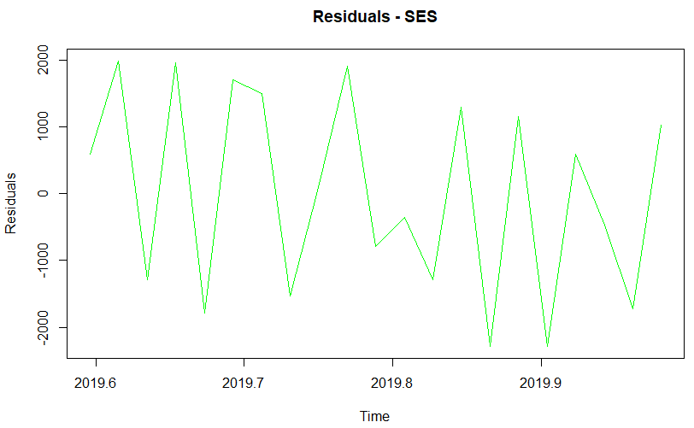

Red Line represents the fitted curve of the naïve and since it considers the last recent value the graph shifted by default drift 1.
Since the residuals are bounded by certain limit, we plotted a separate residual graph.
Residuals are significantly more shown in green denoting that the data is random.

Slide 25
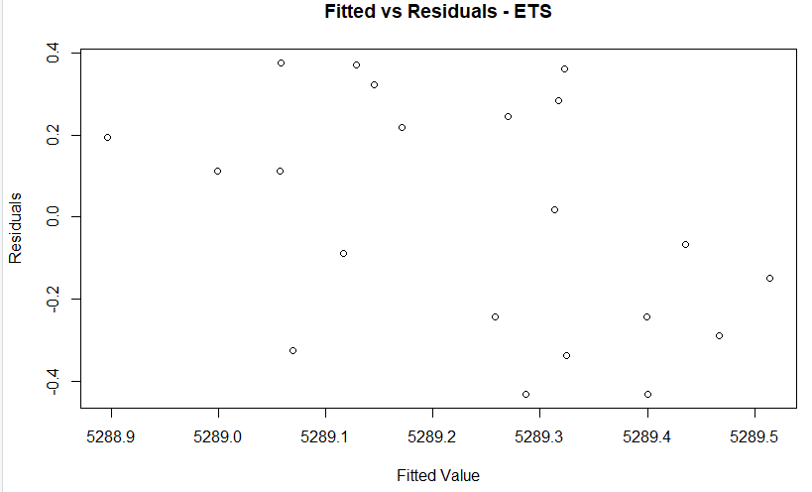
Notes:
ETS(M,N,N)
Call:
ets(y = bf.train)
Smoothing parameters:
alpha = 1e-04 ->this is the smoothing factor
Initial states:
l = 5288.9991
sigma: 0.29

Slide 26
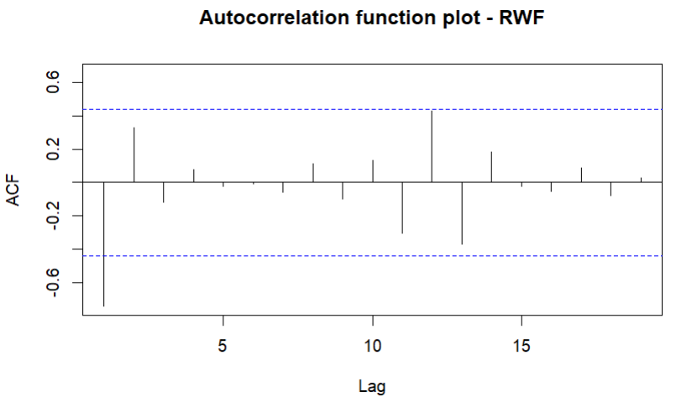
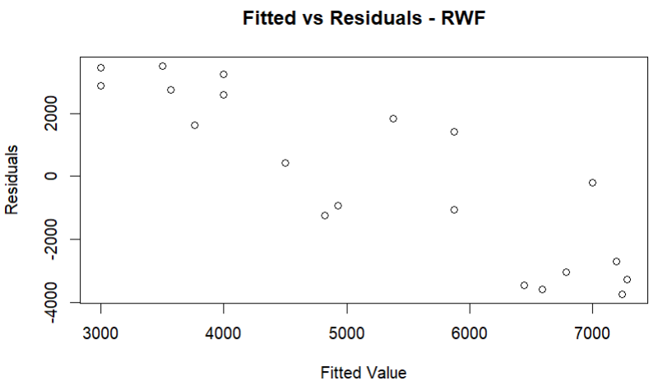
First point is very significant in our plot.
For Fitted vs Residual a decreasing relationship is seen between predicted profit vs actual profit values.

Slide 27
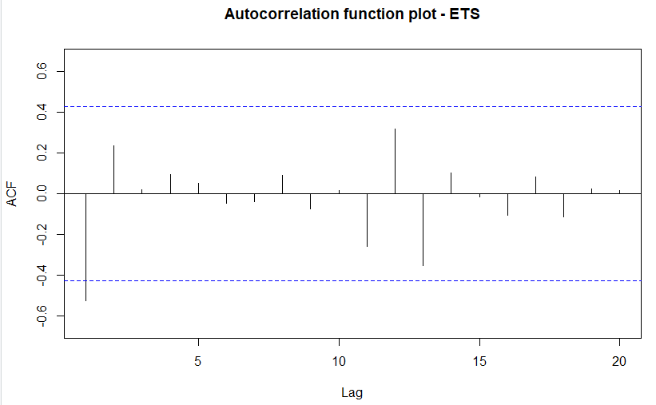
Notes:
ETS(M,N,N)
Call:
ets(y = bf.train)
Smoothing parameters:
alpha = 1e-04 ->this is the smoothing factor
Initial states:
l = 5288.9991
sigma: 0.29

Slide 28
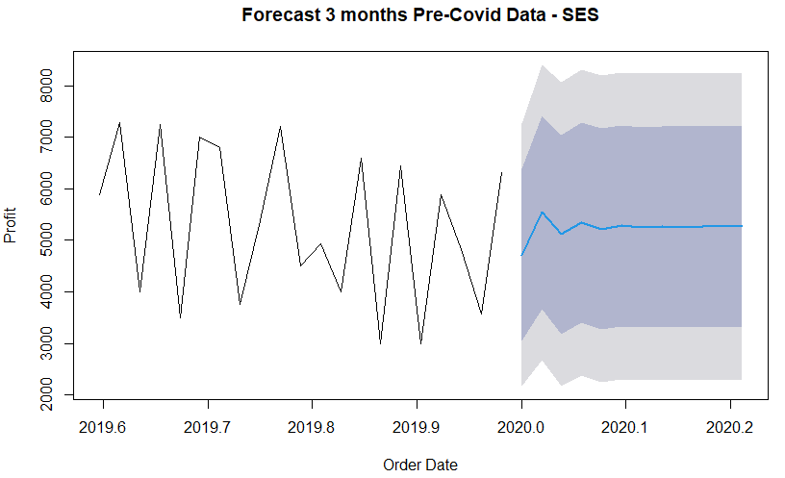
Analysis I – Train Data ARIMA Method

Slide 29
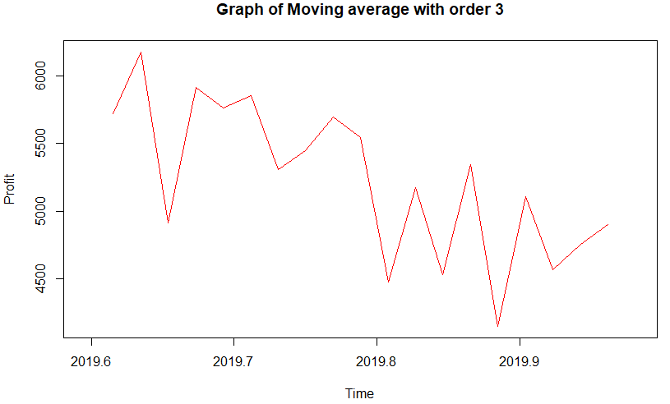
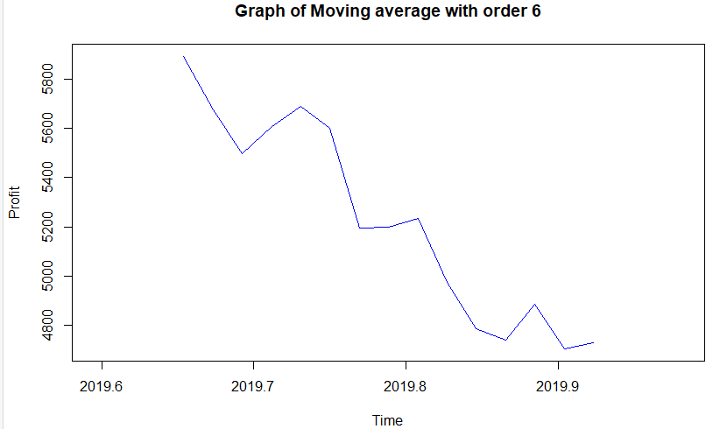
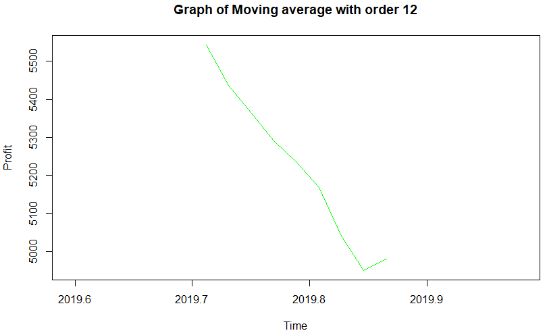
Analysis I – Train Data Moving Averages Method
Notes:
ETS(M,N,N)
Call:
ets(y = bf.train)
Smoothing parameters:
alpha = 1e-04 ->this is the smoothing factor
Initial states:
l = 5288.9991
sigma: 0.29

Slide 30
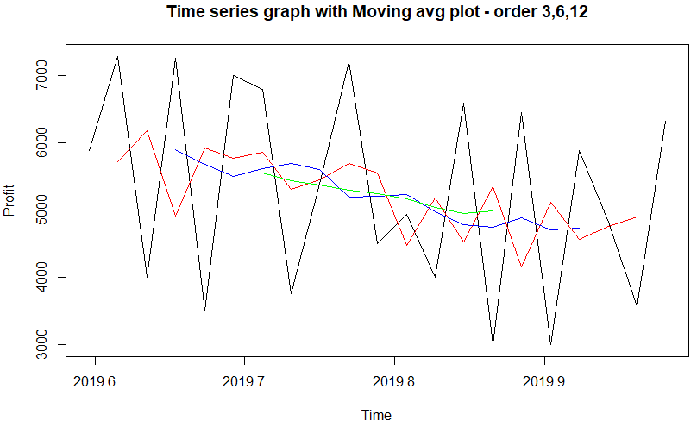
Notes:
ETS(M,N,N)
Call:
ets(y = bf.train)
Smoothing parameters:
alpha = 1e-04 ->this is the smoothing factor
Initial states:
l = 5288.9991
sigma: 0.29

Slide 31
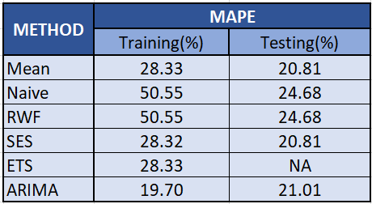
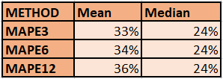
Accuracy Measures – Pre Covid-Data

Slide 32
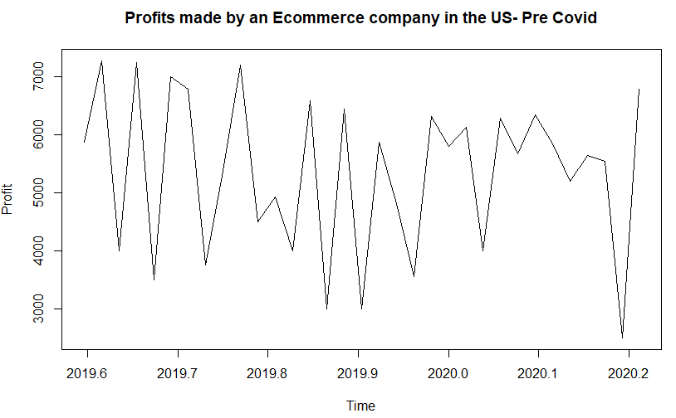
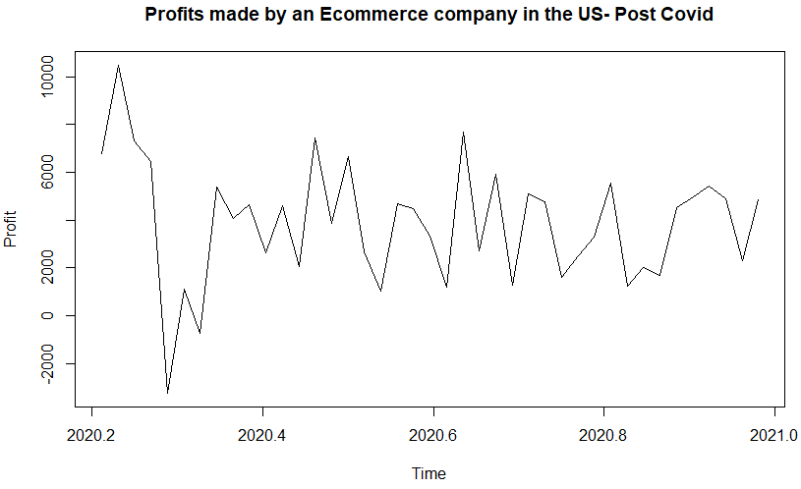
Analysis II – Difference between sale’s profit for Covid and non Covid period

Slide 33
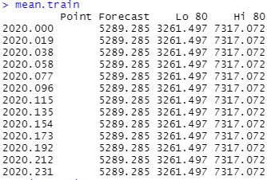
Forecast by Mean Method
Summation of Predicted Profit: $68760.71
Summation of Actual Profit: $52180.50
Difference: $16580.20
% Error: 31.77

Slide 34
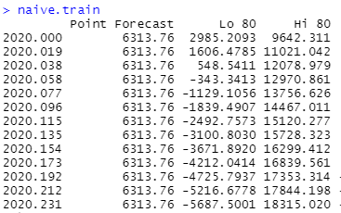
Forecast by Naïve Method
Summation of Predicted Profit: $82078.88
Summation of Actual Profit: $52180.50
Difference: $29898.38
% Error: 57.30

Slide 35
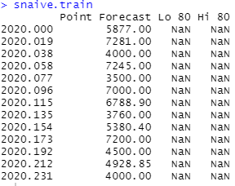
Forecast by SNaïve Method
Summation of Predicted Profit: $71461.15
Summation of Actual Profit: $52180.50
Difference: $19280.65
% Error: 36.95

Slide 36
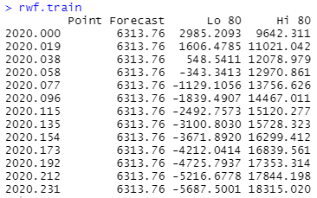
Forecast by RWF Method
Summation of Predicted Profit: $82078.88
Summation of Actual Profit: $52180.50
Difference: $29898.38
% Error: 57.30

Slide 37
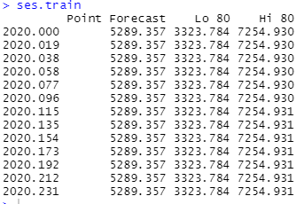
Forecast by Simple Exponential Method
Summation of Predicted Profit: $69667.34
Summation of Actual Profit: $52180.50
Difference: $17486.84
% Error: 33.51

Slide 38
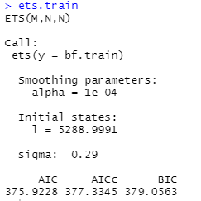
Forecast by Exponential Method
Summation of Predicted Profit: $68756.99
Summation of Actual Profit: $52180.50
Difference: $16576.49
% Error: 31.77

Slide 39
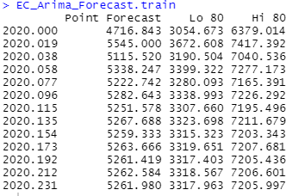
Forecast by Arima Method
Summation of Predicted Profit: $68049.24
Summation of Actual Profit: $52180.50
Difference: $15868.74
% Error: 30.41

Slide 40
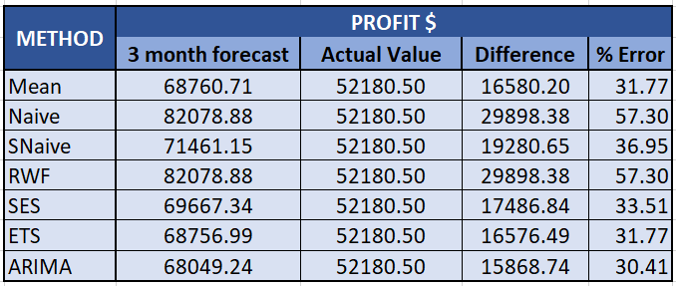
Accuracy Measures
Notes:
Pre Covid: August 2019 - March 2020
Arima is the best model as it fits well with our data
Since we are not considering

Slide 41
Conclusion
There was shoot in profits when the COVID started spreading, considering people were avoiding to go places to shop and willing to be safe at home.
Later on, the data resembles decrease in the profits for an E-commerce company after COVID 19. Companies were trying to recover from their losses and stabilizing their inventories.
Loss maybe due to insufficient inventory, decreased purchasing power since many people loss their jobs etc.

Slide 42
Appendix
https://www.kaggle.com/ammaraahmad/us-ecommerce-record-2020
To add dummy variable in our dataset for better prediction

